Slide 1
Live Video Feed based Online Attendance Capturing Tool

Slide 2
Introduction
Since COVID-19 all lectures, tutorials and meetups have become online. There’s an immediate need for ensuring the students are sincerely attending the lectures instead of faking their attendance by joining the classes.
We are developing a tool to capture attendance and ensure the student is present in front of the device for the whole session. We are using the concept of facial recognition to recognise students’ faces and mark their attendance. This will act as a concept of proof for all instructors to mark attendance and would be a convenient option to collect data with no manual effort.

Slide 3
Implementation Details:
A client side software will run in background during online class sessions to keep track of student attendance.
Working:
A directory to store the student registration ID, name, email, course name and a photo of the student.
Each student will have to keep the tool(software) on their computer. At the start of each session, they have to Login into the tool which will automatically track their attendance.
It’ll use OpenCV to access the video feed from the webcam. Then, it’ll capture a frame in specific intervals (say 10 seconds). It will compare the captured image with the known image in the database. If the students’ face is detected for a minimum no. of times (threshold) then the student is marked present.

Slide 4
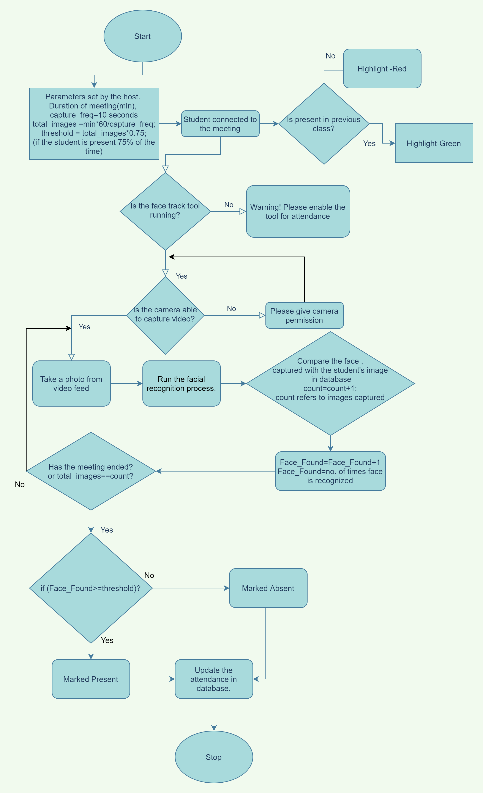
Operational View of the software at a Glance

Slide 5
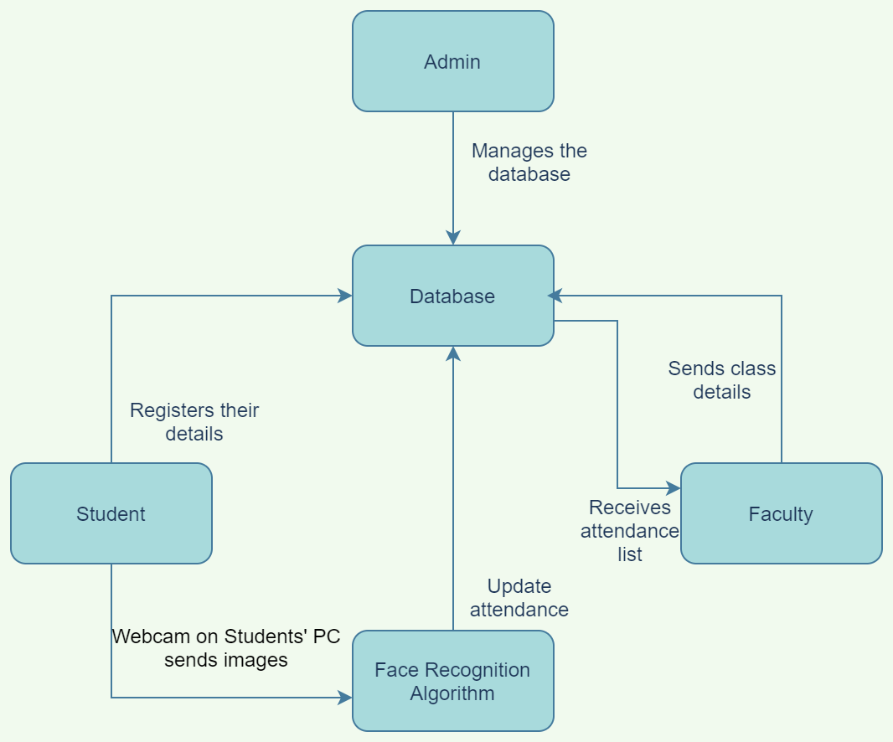
High Level Overview

Slide 6
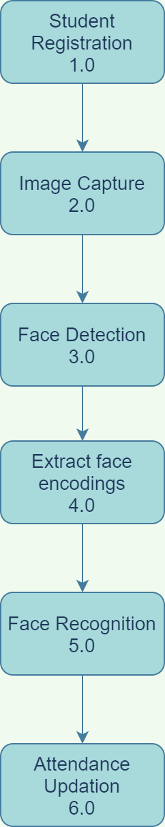
Sub-Process working of the project

Slide 7
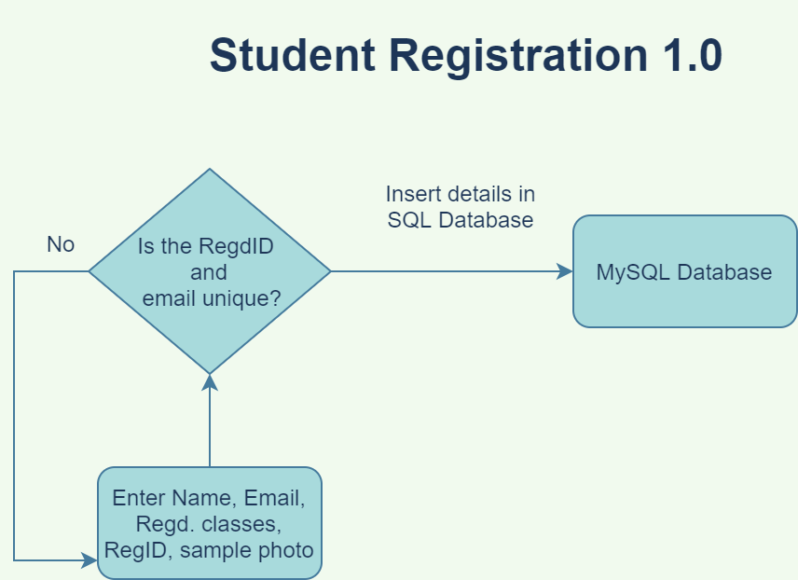

Slide 8
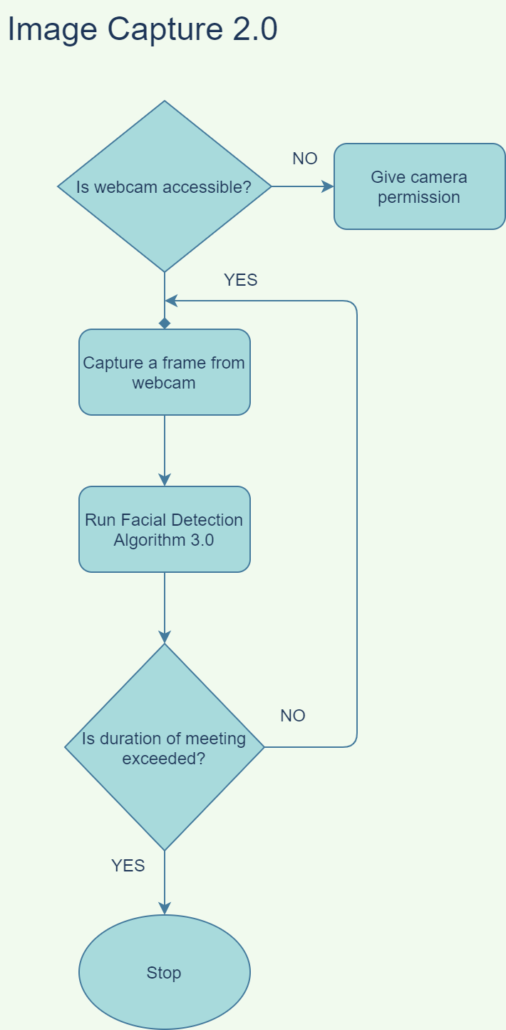

Slide 9
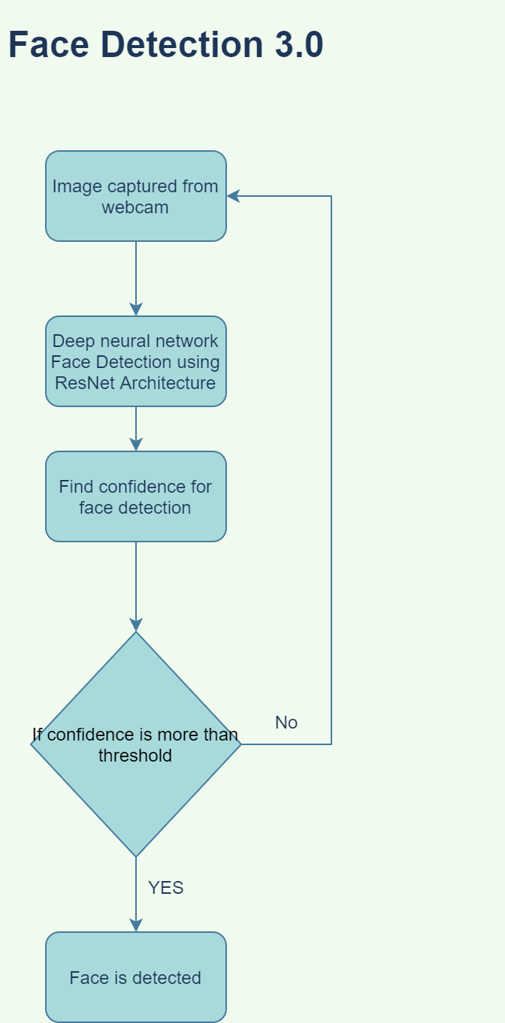

Slide 10
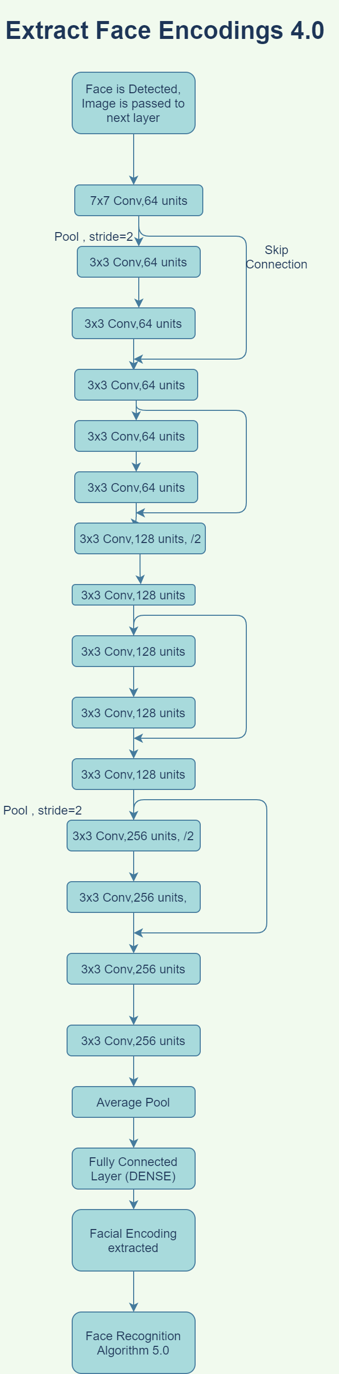
Face Encoding extraction using ResNet-34 Deep learning architecture

Slide 11
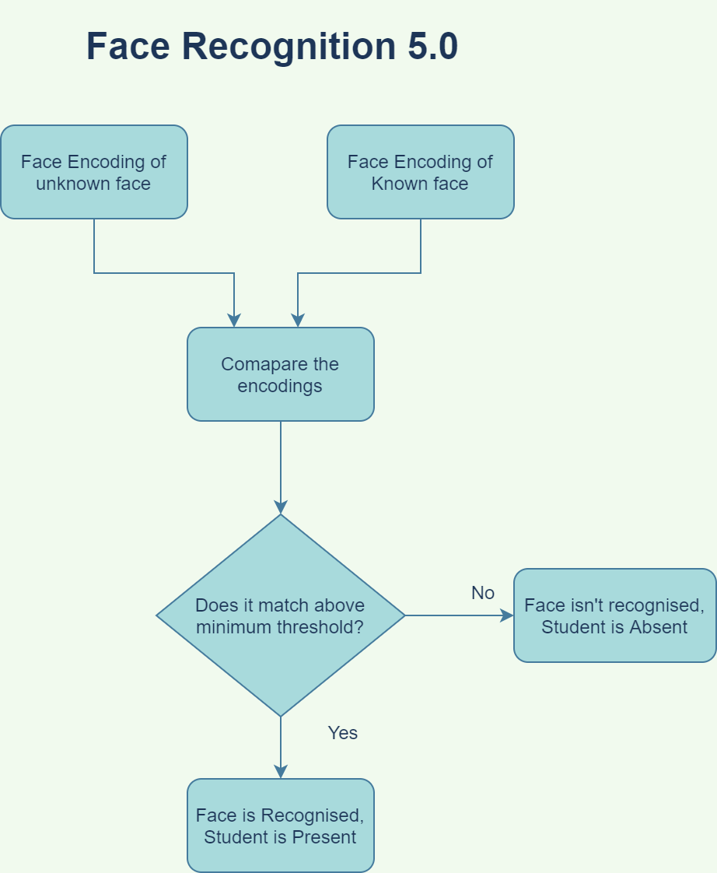

Slide 12
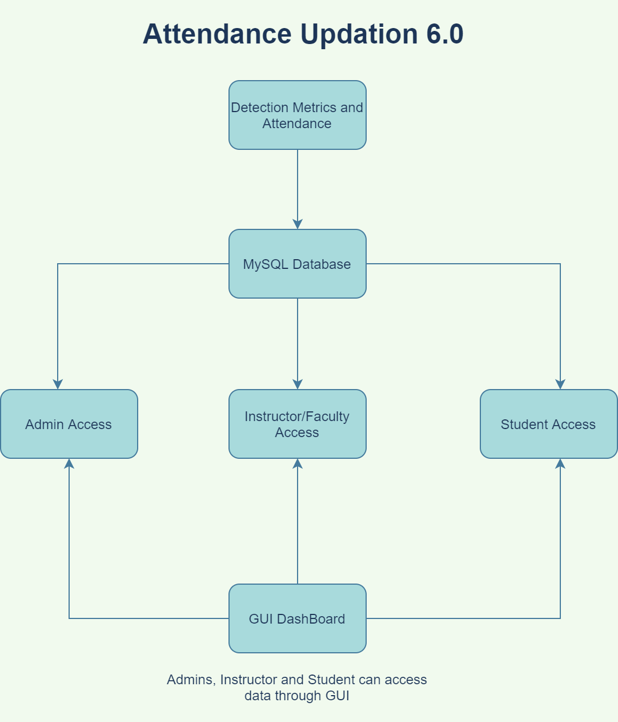

Slide 13
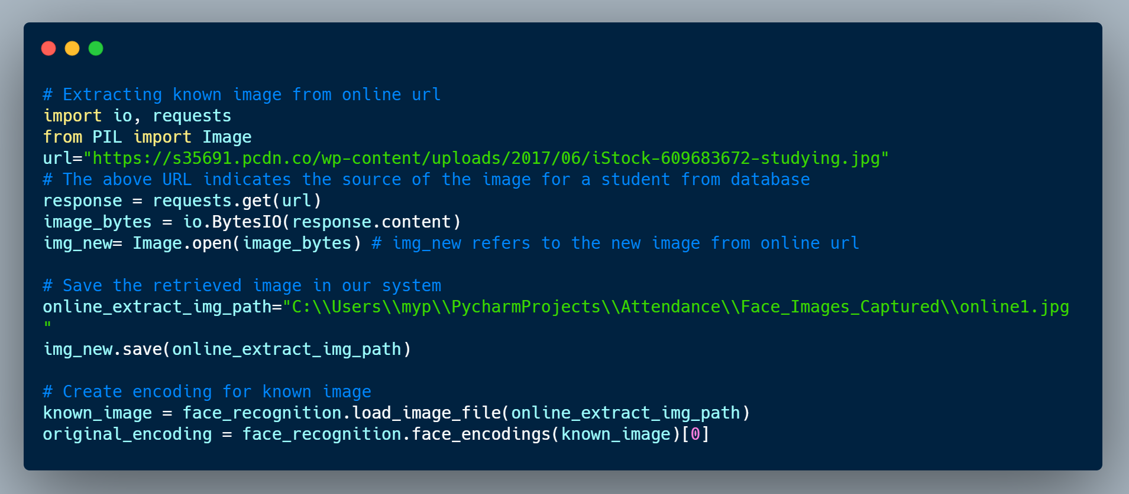
Code Walkthrough:
The above code is a sample code to extract image from a database, and save it into local directory.
Then, we are creating the encoding for the known image which will be compared with subsequent captured images.

Slide 14
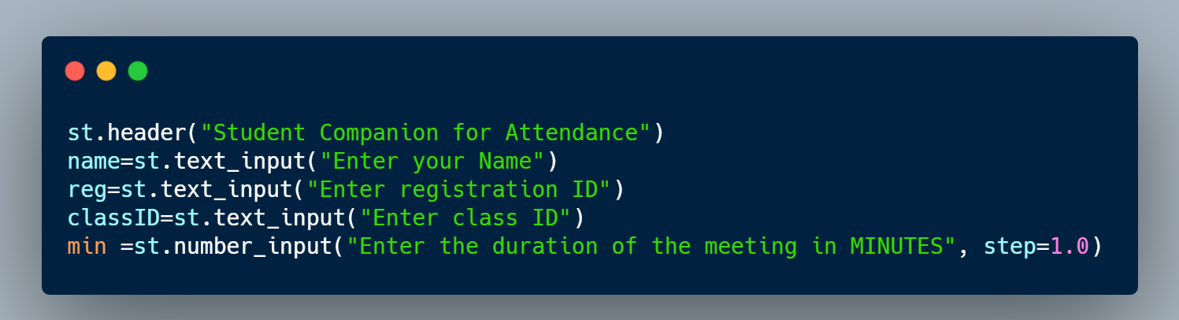
Input constraints:
We are creating a UI in Streamlit for users to enter the required details.
Here, we are taking name, registration ID , class ID and class duration as an input

Slide 15
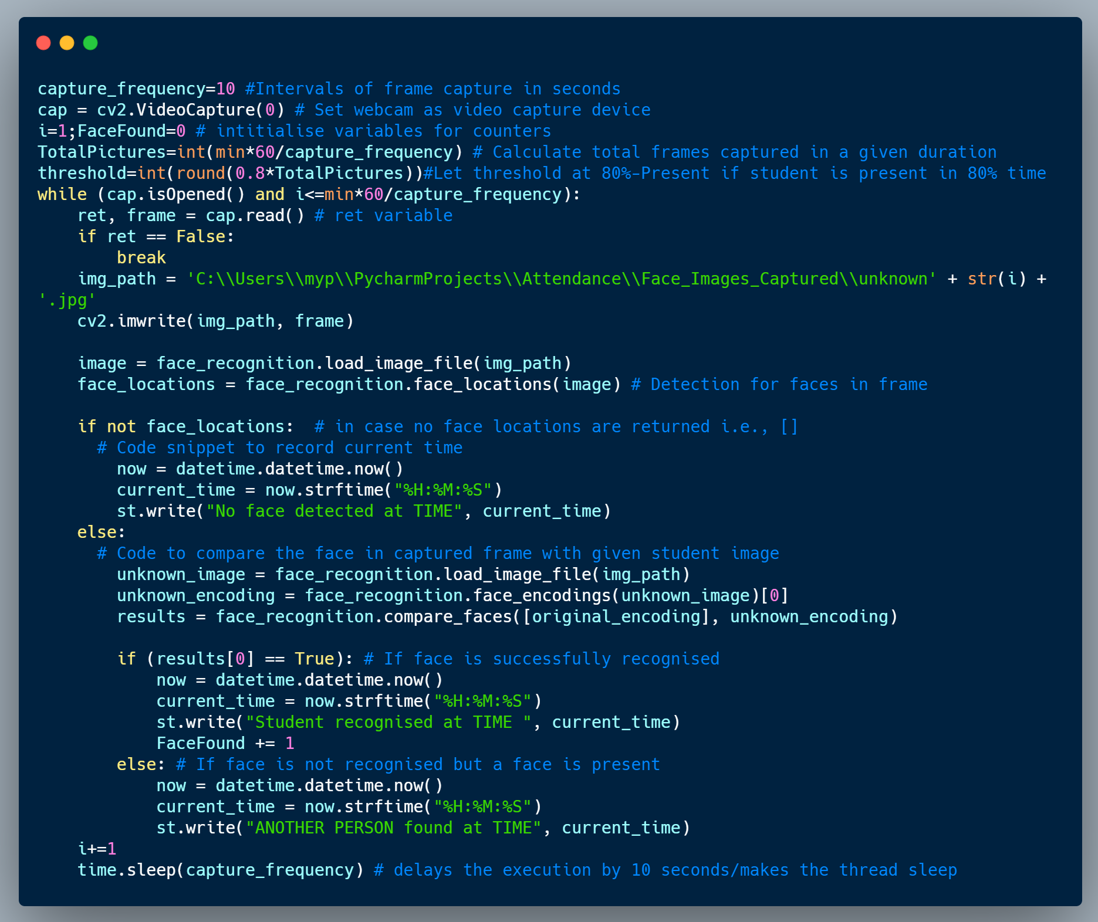
Code for Face Detection and Recognition
Here, we are setting the capture_frequency i.e., the intervals in which a photo is captured from the webcam.
We are keeping the threshold ( the min percentage of time the student must be present for him/her to be marked present) to be 80%.
Then, we are setting up a loop to repeat the capture and recognition process until the end of the meeting.
In each iteration of the loop, we first detect the presence of a face. If present, we try to compare the facial encodings of the captured face with the known face of student. If they match, then the FaceFound counter is increased by 1. Else, it is said that Another person is present.
We are then making the current thread sleep for n seconds(capture_frequency) to wait for next iteration.

Slide 16
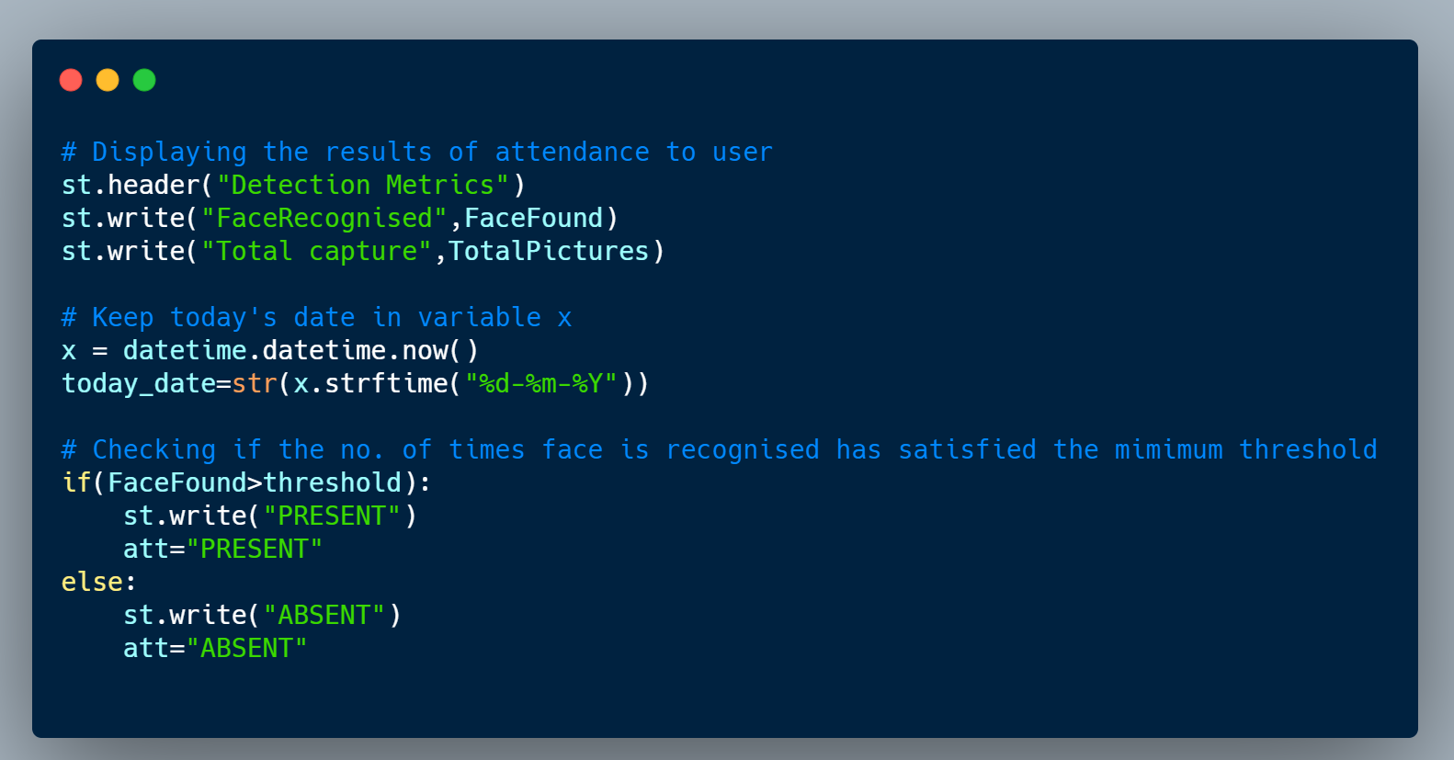
Letting the student know about their attendance for current class

Slide 17
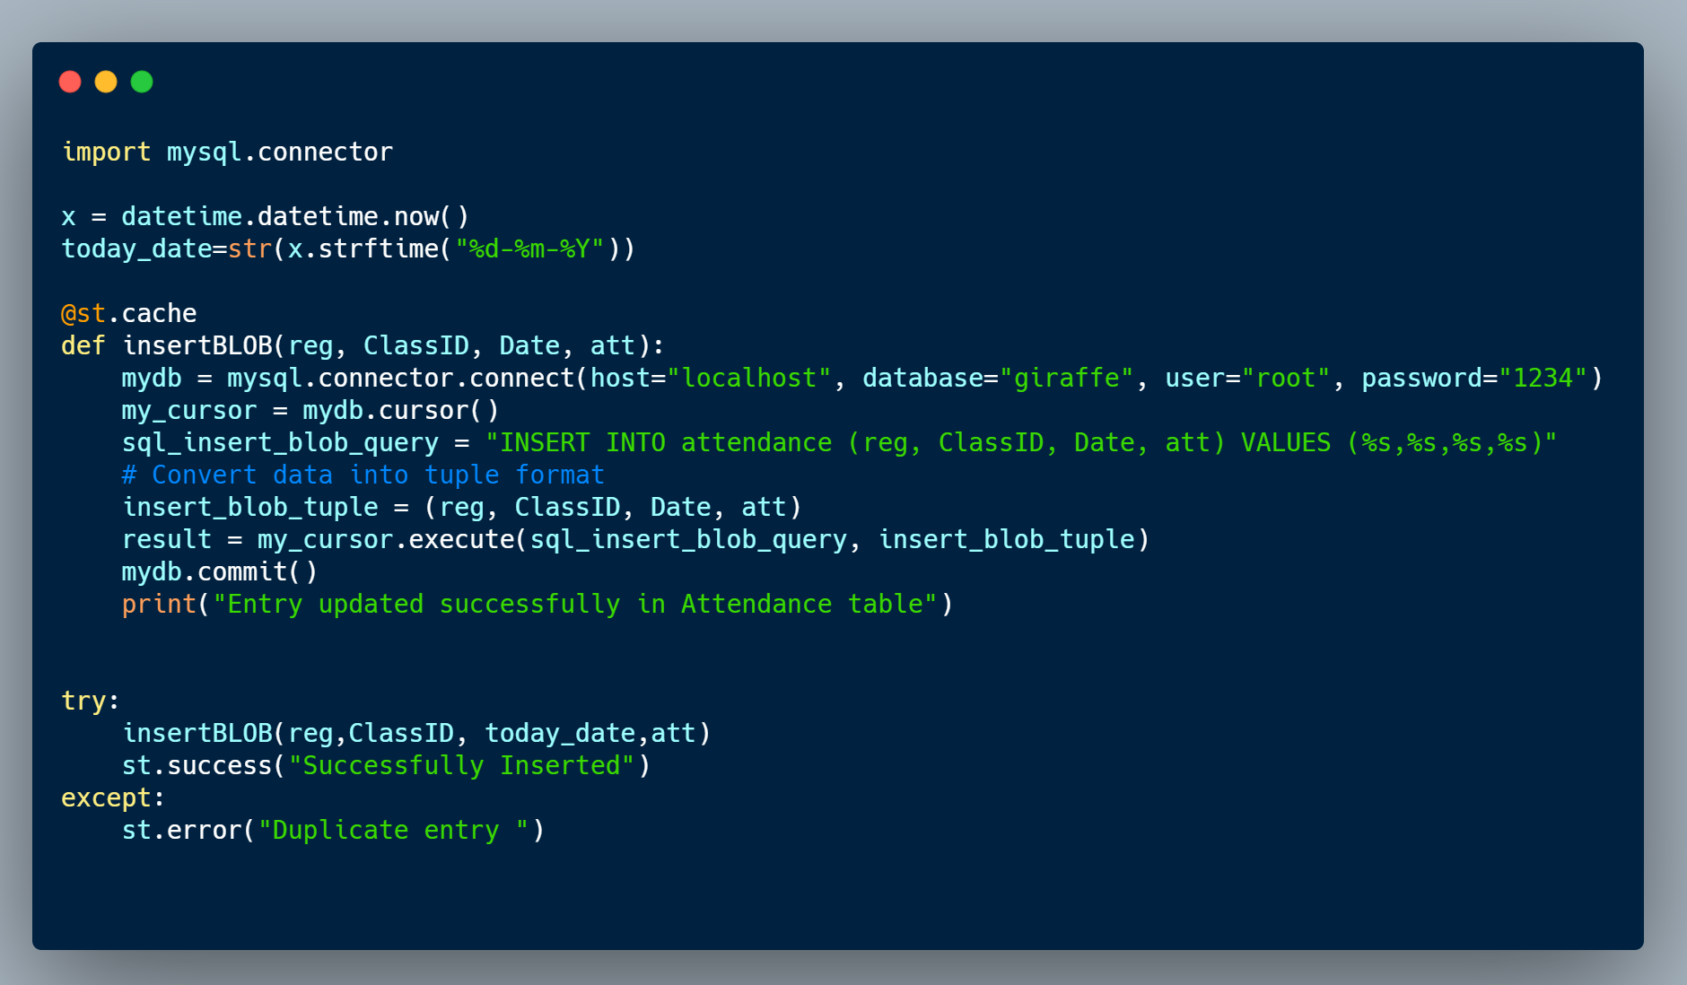
Updating the data in SQL database
At the end of each lecture/class, we update the details regarding the attendance into a SQL database with registration ID as Primary Key.

Slide 18
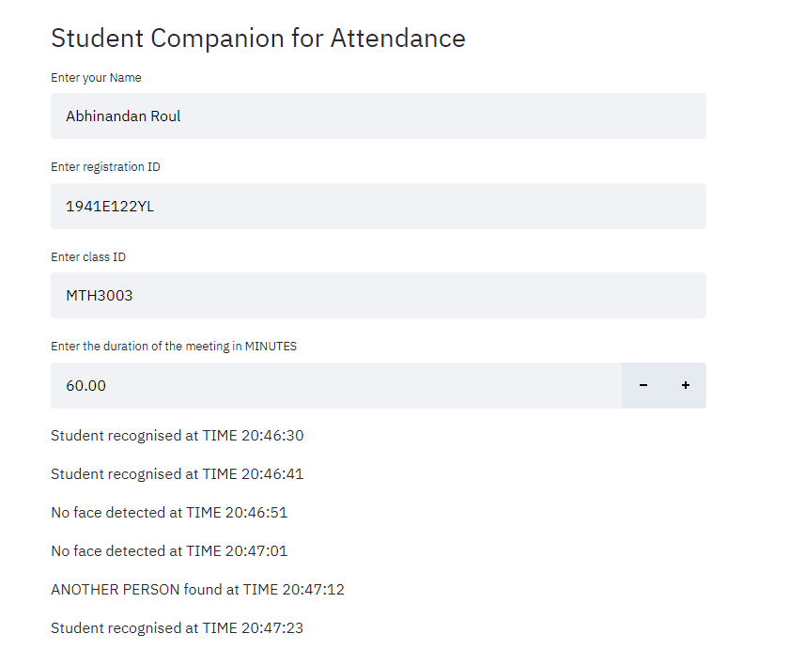
Client Side Streamlit based GUI to start the application
Indicates successful recognition
Student is AWAY
Someone else is present instead of student
It’ll show detection metrics after the end of the complete duration.

Slide 19
Required frameworks:
Python as primary language for developement
Streamlit for GUI development
OpenCV for continuous video capturing.
Flask/Django for website interface for Admins
Face Recognition library by Dlib-
(Built using dlib’s state-of-the-art face recognition built with deep learning. The model has an accuracy of 99.38% on the Labeled Faces in the Wild benchmark.)
MySQL and Firebase for database management
Javascript to develop chrome tool for deployment
Challenges:
Highlighting the students’ face in Green and Red according to their attendance in previous class.

Slide 20
Future Scope
This tool will act as a monitoring method in universities, schools and offices during online meetings and lectures.
It can be modified to act as an attendance capture tool in physical classrooms and corporate firms.
This tool will be tested in different test cases.

Slide 21
Thank You

